Slide 1
The Jasmine Effect
Automate; Don't Panic.

Slide 2
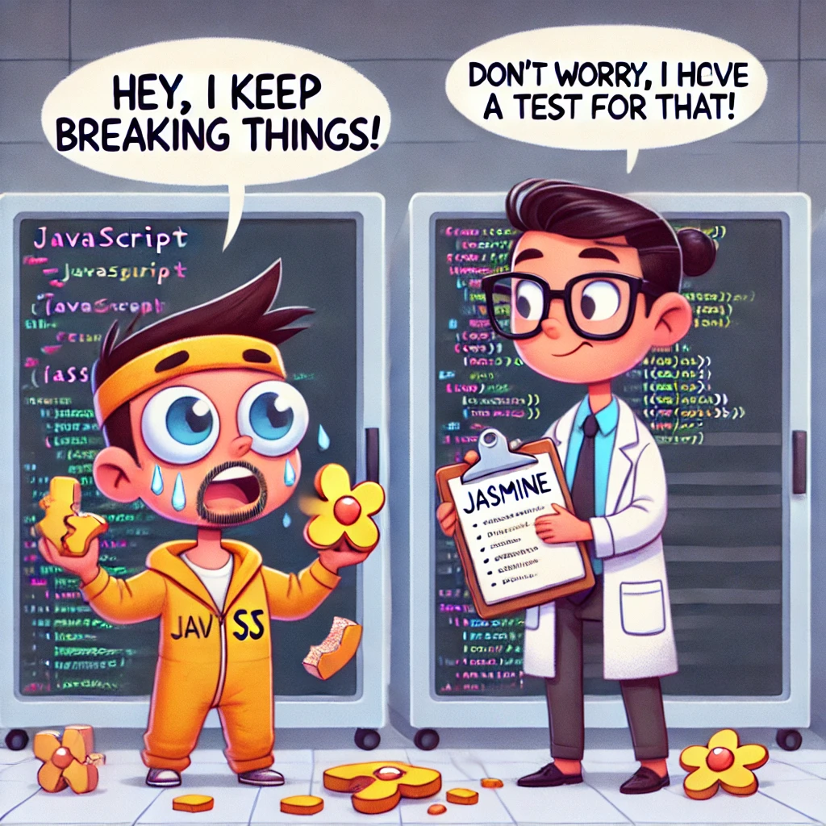
Jasmine’s Got Your Back
Jasmine is a lightweight testing framework for testing JavaScript code.
It does not depend on any other JavaScript frameworks.
It runs in browsers and in Node.js.
And it has a clean, obvious syntax so that you can easily write tests.
Think of it as a detective who catches bugs before they cause trouble.
Automated, consistent testing.
Catching bugs early in development.
Improving script quality and maintainability.

Slide 3

Prototype
Created by Sam Stephenson in 2005 to simplify and improve the process of writing JavaScript for web development.
It provided various utilities and extensions to the JavaScript language, such as:
Extending built-in JavaScript objects like Array, String, and Function.
Easier DOM traversal and manipulation.
Cross-browser support.

Slide 4
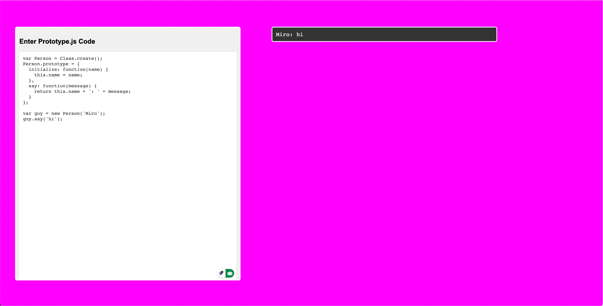
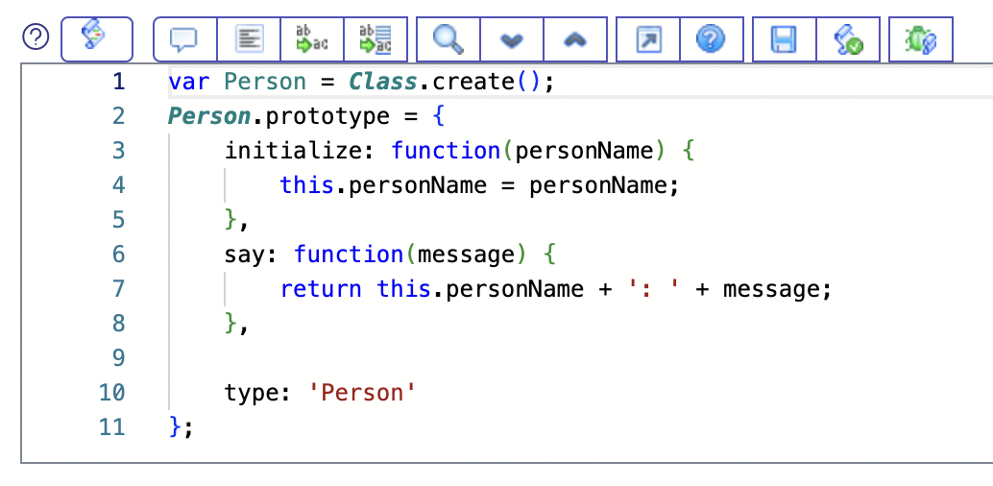
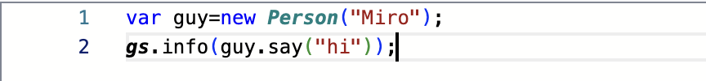
ServiceNow's Secret Sauce

Slide 5
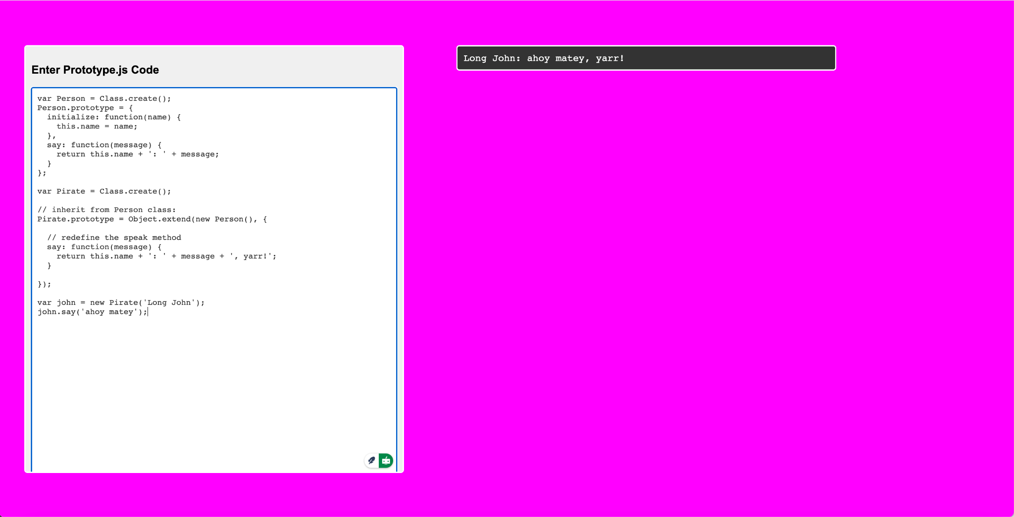
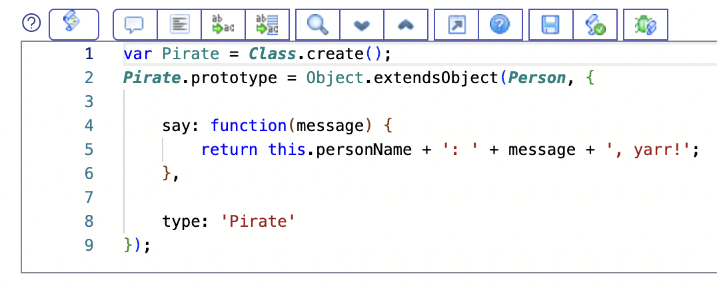
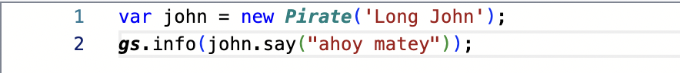
ServiceNow's Secret Sauce

Slide 6

Script Includes
Script Includes are reusable server-side script logic that define a function or class.
Script Includes execute their script logic only when explicitly called by other scripts.
They are a powerful way to write code that can be called from multiple places, making your instance more modular, maintainable, and efficient.

Slide 7
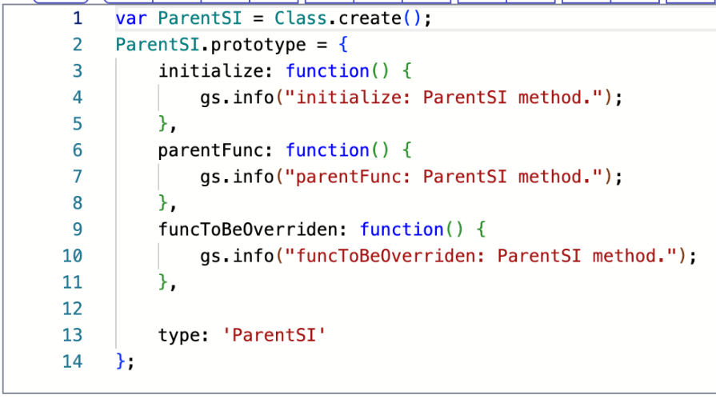
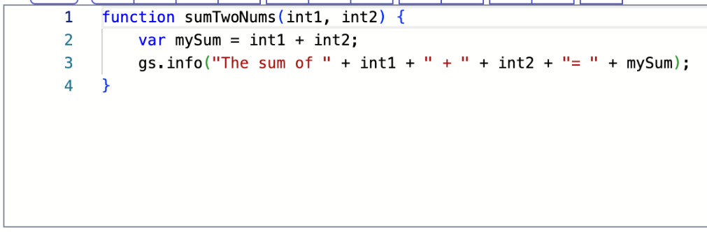
Script Includes Patterns

Slide 8
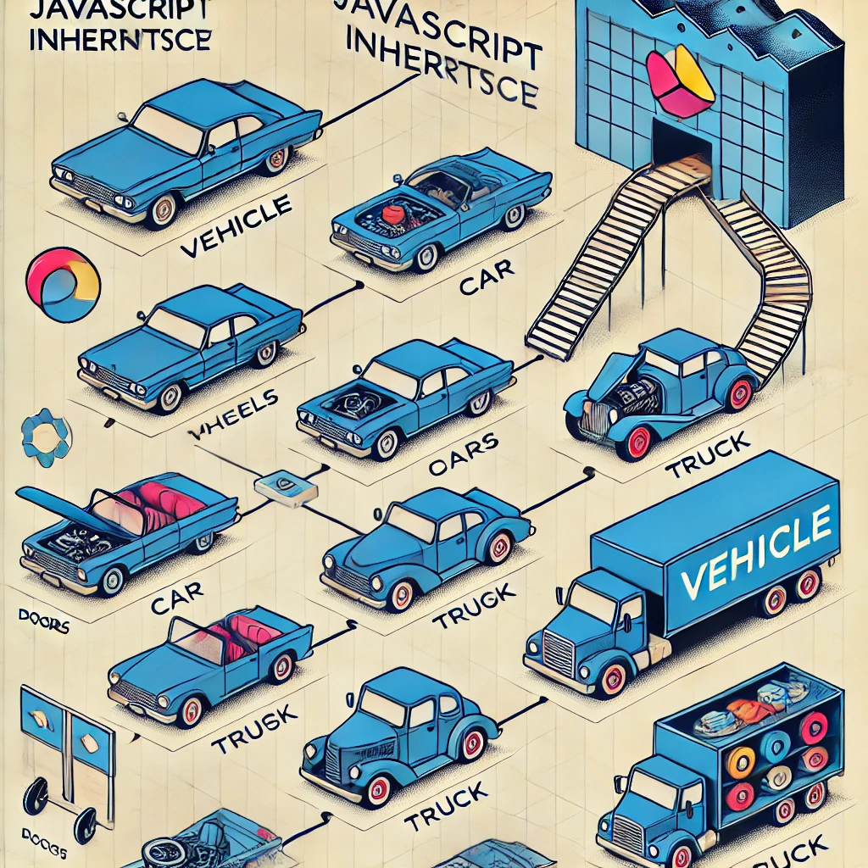

Inheritance

Slide 9
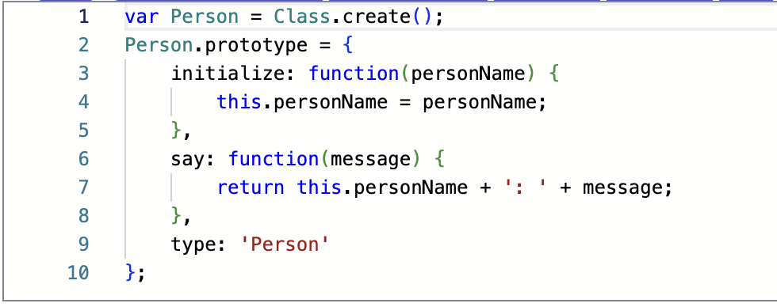
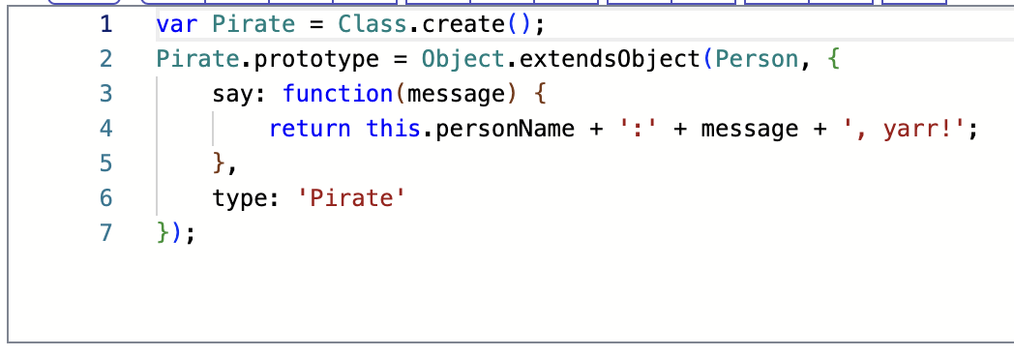
Script Includes Patterns

Slide 10
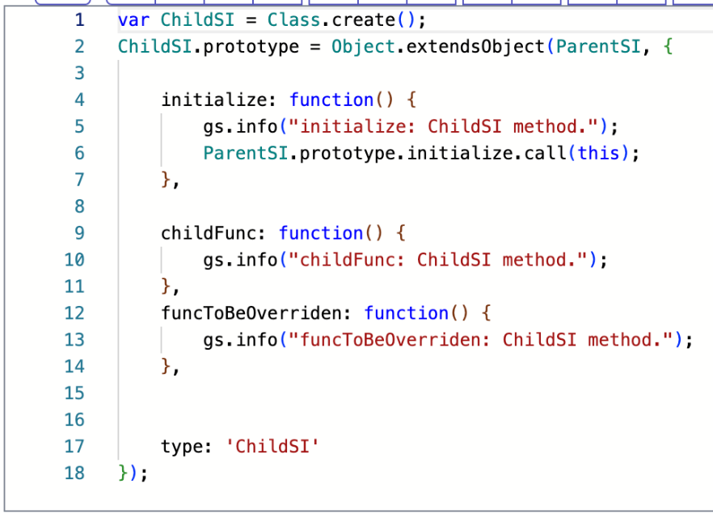
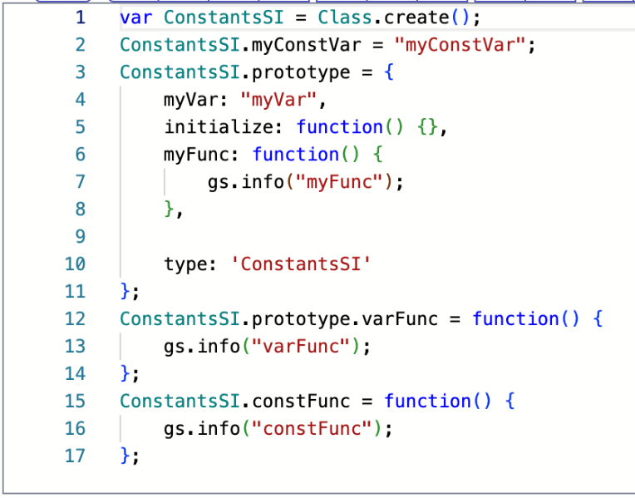
Script Includes Patterns

Slide 11
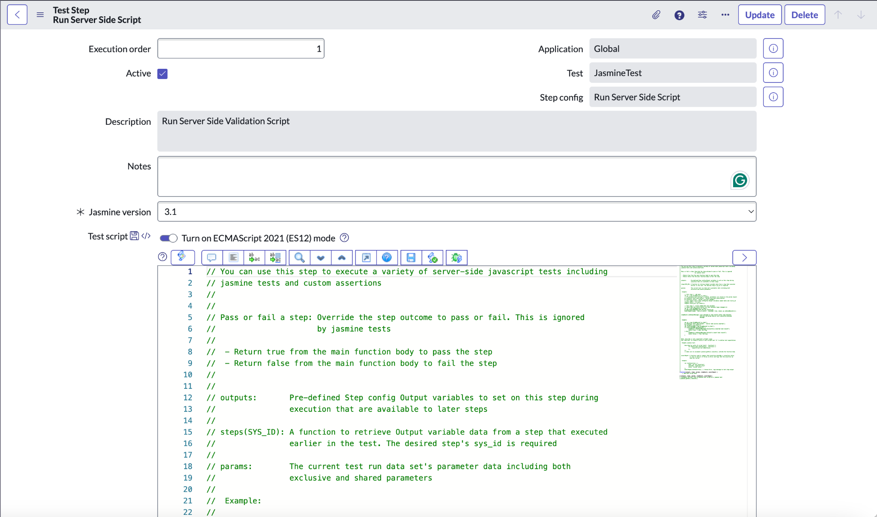
Run Server Side Script

Slide 12
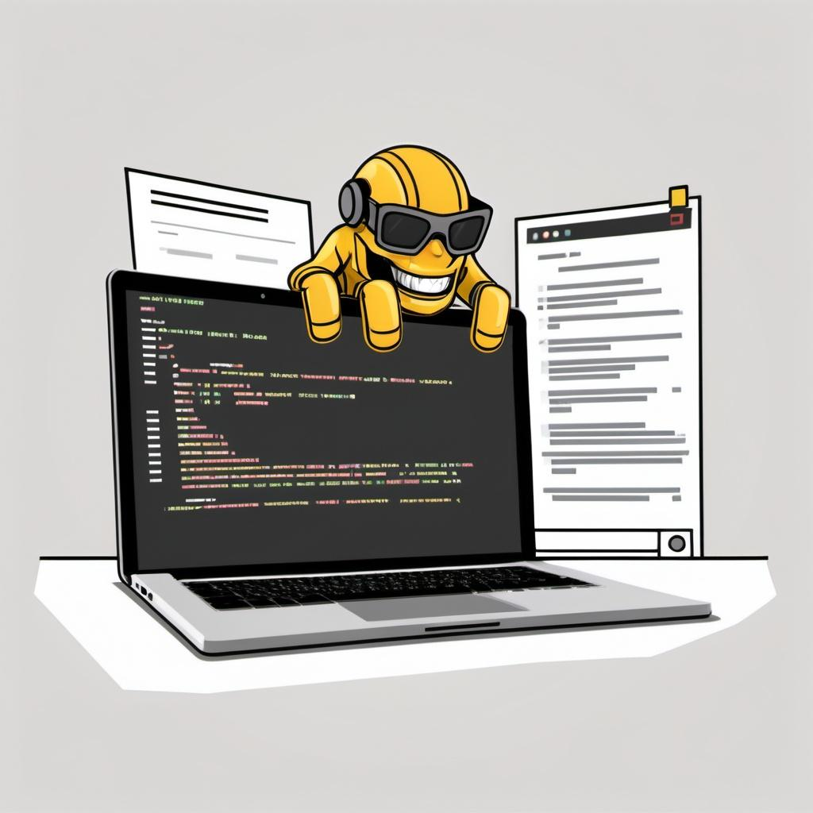
Suites: describe Your Tests
The describe function is for grouping related specs; typically, each test file has one at the top level.
The string parameter is for naming the collection of specs, and will be concatenated with specs to make a spec's full name.
This aids in finding specs in a large suite.
If you name them well, your specs read as full sentences in traditional BDD style.

Slide 13

Specs
Specs Specs are defined by calling the global Jasmine function it, which, like describe takes a string and a function.
The string is the title of the spec and the function is the spec, or test.
A spec contains one or more expectations that test the state of the code.
An expectation in Jasmine is an assertion that is either true or false.
A spec with all true expectations is a passing spec.
A spec with one or more false expectations is a failing spec.

Slide 14

Expectations
Expectations are built with the function expect which takes a value, called the actual.
It is chained with a Matcher function, which takes the expected value.

Slide 15

Matchers
Each matcher implements a boolean comparison between the actual value and the expected value.
It is responsible for reporting to Jasmine if the expectation is true or false.
Jasmine will then pass or fail the spec.
Any matcher can evaluate to a negative assertion by chaining the call to expect with a not before calling the matcher.
Jasmine has a rich set of matchers included, you can find the full list in the API docs.

Slide 16

Setup and Teardown
To help a test suite DRY up any duplicated setup and teardown code, Jasmine provides the global beforeEach, afterEach, beforeAll, and afterAll functions.
As the name implies, the beforeEach function is called once before each spec in the describe in which it is called and the afterEach function is called once after each spec.
The beforeAll function is called only once before all the specs in describe are run, and the afterAll function is called after all specs finish.
beforeAll and afterAll can be used to speed up test suites with expensive setup and teardown.

Slide 17

The this keyword
A way to share variables between a beforeEach, it, and afterEach is through the this keyword.
Each spec's beforeEach/it/afterEach has the this as the same empty object that is set back to empty for the next spec's beforeEach/it/afterEach.
Note: If you want to use the this keyword to share variables, you must use the function keyword and not arrow functions.

Slide 18

Disabling Suites
Suites can be disabled with the xdescribe function.
These suites and any specs inside them are skipped when run and thus their results will show as pending.
Suites can also be focused with the fdescribe function.
That means only fdescribe suits will run.

Slide 19

Pending Specs
Pending specs do not run, but their names will show up in the results as pending.
Any spec declared with xit is marked as pending.
Any spec declared without a function body will also be marked pending in results.
And if you call the function pending anywhere in the spec body, no matter the expectations, the spec will be marked pending.
A string passed to pending will be treated as a reason and displayed when the suite finishes.
Tests can also be focused with the fit function.
That means only fit tests will run.

Slide 20

Manually failing a spec with fail
The fail function causes a spec to fail.
It can take a failure message or an Error object as a parameter.

Slide 21

Spies
Jasmine has test double functions called spies.
A spy can stub any function and tracks calls to it and all arguments.
A spy only exists in the describe or it block in which it is defined, and will be removed after each spec.
You can define what the spy will do when invoked with and.
There are special matchers for interacting with spies.
The toHaveBeenCalled matcher will pass if the spy was called.
The toHaveBeenCalledTimes matcher will pass if the spy was called the specified number of times.
The toHaveBeenCalledWith matcher will return true if the argument list matches any of the recorded calls to the spy.

Slide 22

Spies: createSpy
When there is not a function to spy on, jasmine.createSpy can create a "bare" spy.
This spy acts as any other spy - tracking calls, arguments, etc; But there is no implementation behind it.

Slide 23
References
http://prototypejs.org/
https://beingfluid.github.io/ptototypejstest/
Objects: Making It A Little Easier…
Script Includes
NOWCommunity Live Stream - Code Decoded - Using a Constants script include
Live Coding Happy Hour for 2017-02-10 - Server Scripts with Automated Test Framework
Unit testing your Javascript with jasmine
https://jasmine.github.io/
Unlearn Series - Unit Test Your Script Include Using ATF
Learning Unit Testing with Jasmine
https://beingfluid.github.io/ptototypejstest/code.html

